Slide 1
Classes and Objects
18ESC108A Elements of Computer Science and Engineering
B. Tech. 2018
Ami Rai E.
Roopa G
Chaitra S
Department of Computer Science and Engineering
Faculty of Engineering and Technology
Ramaiah University of Applied Sciences

Slide 2
Objectives
At the end of this lecture, student will be able to
Explain the concept of object oriented programming
Define classes and instantiate them
Define and use instance variables

Slide 3
Topics
Classes
Instances
Methods

Slide 4
Object Oriented Programming
A key aspect of the object oriented approach is to break the problem into smaller understandable parts (divide and conquer)
A program is made up of many cooperating objects
An object is a bit of self-contained code and data
Instead of being the “whole program” - each object is a little “island” within the program and cooperatively working with other objects

Slide 5
Definitions
Class - a template of an entity that exists in the real world
dog
Object - an instance of a class
Lassie
Method - a defined capability of a class
bark()
Attribute- a bit of data in a class
length

Slide 6
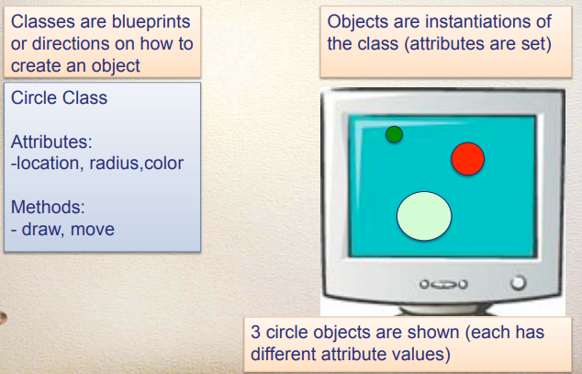
Class and Object - Example

Slide 7
Applications of Object Oriented Programming
For example, banking software can be developed
A new Bank Account can be opened with minimum balance
A specified amount can be deposited into the Account
A specified amount may be withdrawn from the Account
A specified Account may be closed
Thus a Python program can open an account, deposit amount into an account and so on
In general, a Python program can create objects and perform operations on objects

Slide 8
Operations on Objects
Query operations may be performed on objects
For example, the balance amount in a bank account may be queried
Query operations on objects are read only and do not change the state of the object
Update operations may be performed on objects
For example, a specified amount can be deposited into an account
A specified amount may be withdrawn
Update operations on objects perform writes and change the state of the object

Slide 9
Defining Classes
A class is the design of an entity that exists in the real world
The syntax of defining a class in Python:
class className:
statements
The statements within a class can be nay of the following
Blank lines
Comments
Class variables
Class functions

Slide 10
Defining Classes - Example
# Date is an empty class
>>> class Date:
... """First implementation of the Date class"“”
... pass
...
>>> Date.__doc__
'First implementation of the Date class'

Slide 11
Instantiating Classes
Once the class definition is done, it is possible to instantiate it and create objects
The syntax for instantiating a class, creating an object and storing it’s reference in a variable:
Var = ClassName()
Example
>>> d=Date()
>>> d
<__main__.Date instance at 0x0000000005E13B08>
>>> type(d)
<type 'instance'>
>>> d.__doc__
'First'

Slide 12
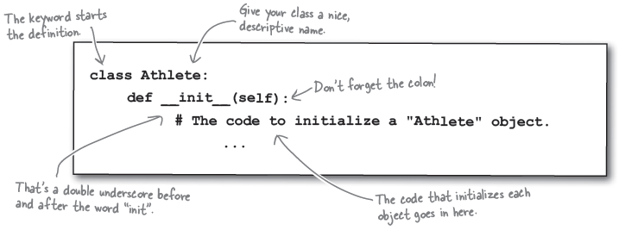
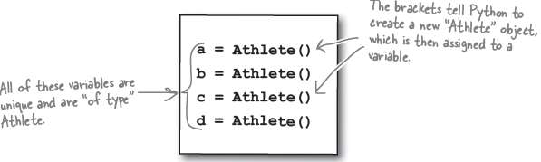
Creating Object Instances – Example

Slide 13
Class Variables and Instance Variables
Class Variables
Variables that belong to class
It is shared across instances of that class
Accessible using the class name (the class object) or any instance of that class
Instance Variables
Variables that belong to an object

Slide 14
Class Variables - Example
# class A with class variable x initialized to 10
>>> class A:
... x=10
...
>>> A.x
10
>>> a=A() #creating object
>>> a.x
10
>>> b=A() #creating another object
>>> b.x
10

Slide 15
Class Variables contd.
>>> a.x=30 # When an assignment is made to a variable using an instance, the # variable is assumed to be an instance variable
>>> A.x
10
>>> a.x
30
>>> b.x
10

Slide 16
Class Variables contd.
>>> A.x=50 # Assignment to the class variable using the class object
>>> A.x
50
>>> a.x
30
>>> b.x
50

Slide 17
Class Functions
Class functions – functions defined within a class
They are methods only when an object is used to invoke the function
>>> class A:
... x=10
... def increment():
... x=x+1
...
>>> A.x
10
>>> A.increment()
>>> A.x
10

Slide 18
Instance Variables
The object can create whatever instance variables it desires
It is possible for different objects of the same class to have different instance variables (not a good idea)
>>> class Date:
... def setDate(self,d,m,y): # setDate is a function of the class Date
... self.day, self.month, self.year = d,m,y # self.day, self.month, self.year are instance # variables
...
>>> d=Date()
>>> d.setDate(1,2,2000)
>>> d.day
1
>>> d.month
2

Slide 19
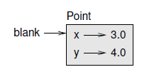
Object Diagram
Object diagram - A state diagram that shows an object and its attributes
Consider the code
>>> class Point: #empty class
... pass
...
>>> blank=Point() # The return value is a reference to a Point object, which is assigned to # blank
>>> blank.x=3.0
>>> blank.y=4.0

Slide 20
Summary
Object-oriented programming (OOP) involves programming using objects
An object represents an entity in the real world that can be distinctly identified
A class is a design according to which objects can later be instantiated
An object is an instance of a class
Classes can be defined using the keyword class
Class variables are defined directly within a class
Class functions are functions defined within the class that are not dependent on the invoking object

